Slide 1
COMMON
BIRDS
OF KERALA
A PRESENTATION BY
Abhinand Chandran
Calicut
Jolly Kacheri
Calicut
Naveenlal P.
Calicut
Vijesh Vallikunnu
Calicut
raptorsmalabar@gmail.com

Slide 2
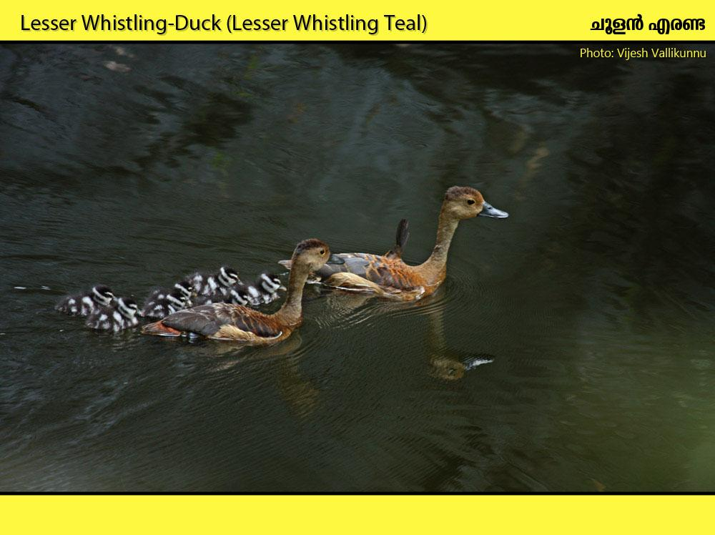
Habitat: Freshwater and wetlands.

Slide 3
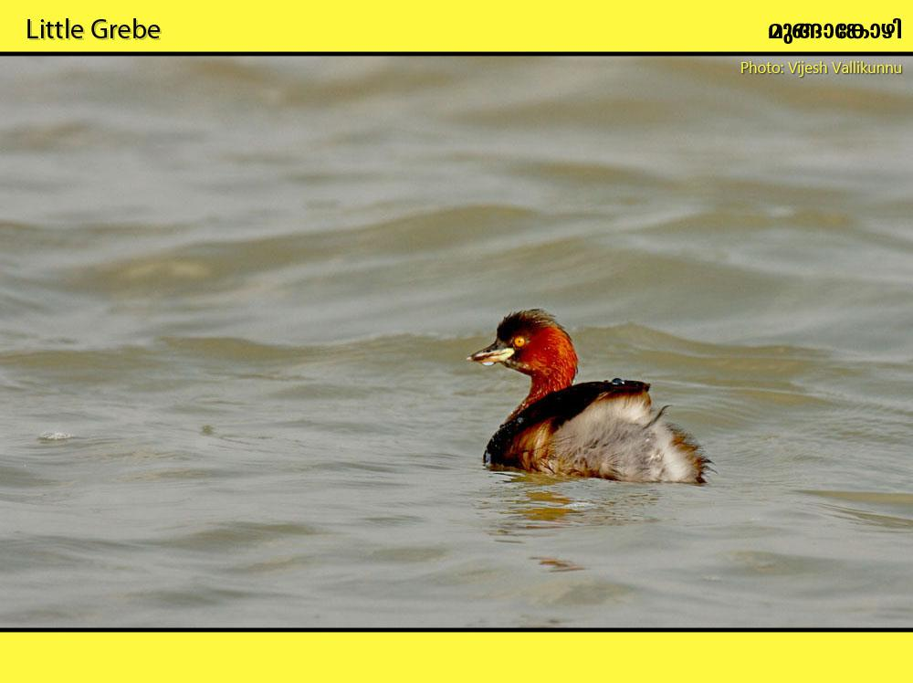
Habitat: Lakes, ponds, village tanks, reservoirs, ditches

Slide 4
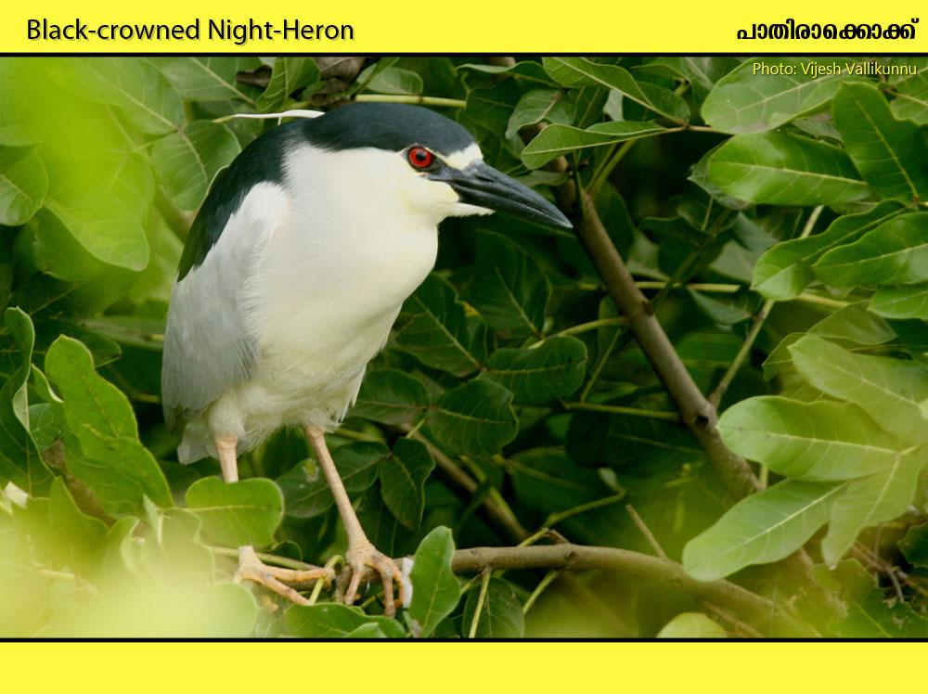
Habitat: Usually spends the day sitting hunched in a densely foliaged tree. Ponds, tanks, lakes, streams, mangroves. frequently seen flying with a harsh craw sound in the evenings

Slide 5
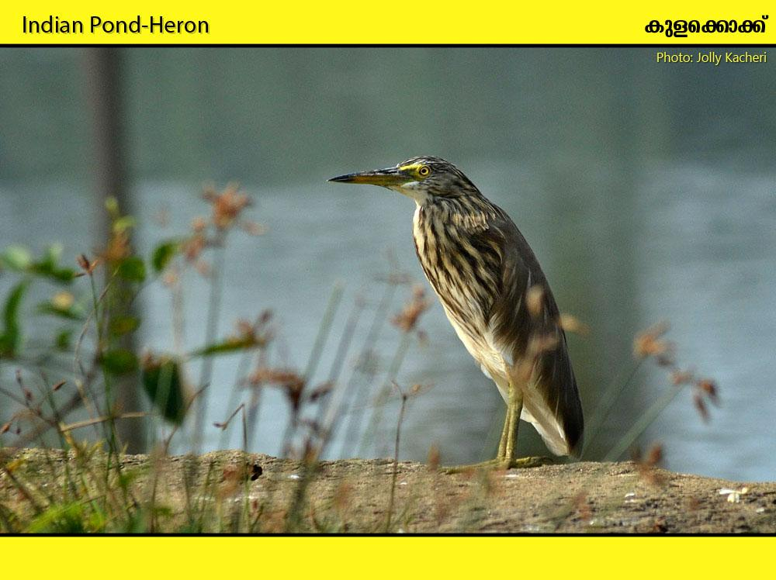
Habitat: Marshes, flooded paddy-fields, lakes, village tanks, ditches, and tidal mudflats. white seen in flight

Slide 6
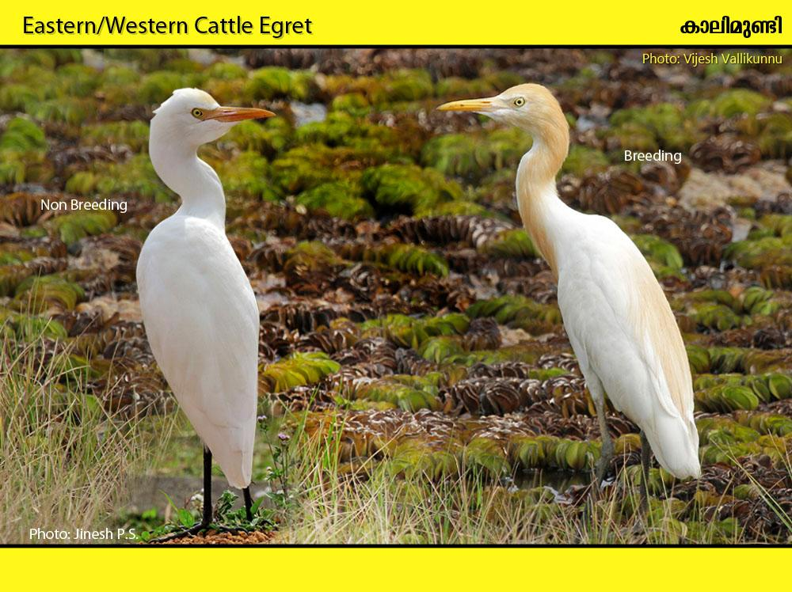
Habitat: Typically seen in flocks around Cattle, feeding on insects disturbed by the animals. Damp grassland, paddy-fields, grass banks of village tanks, canals and lakes.

Slide 7
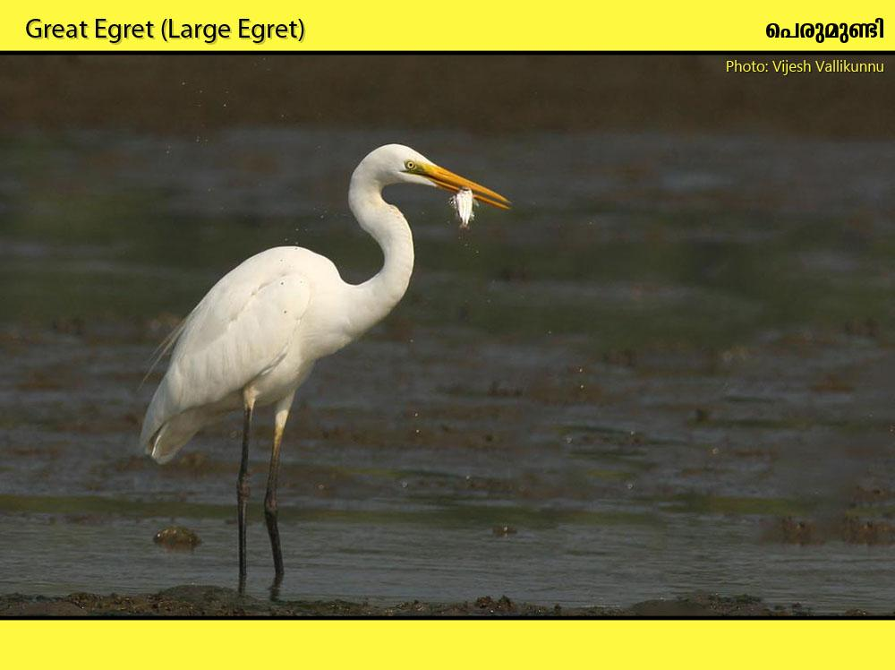
Habitat: Rivers, lakes, marshes, estuaries, mangroves and coral reefs.

Slide 8
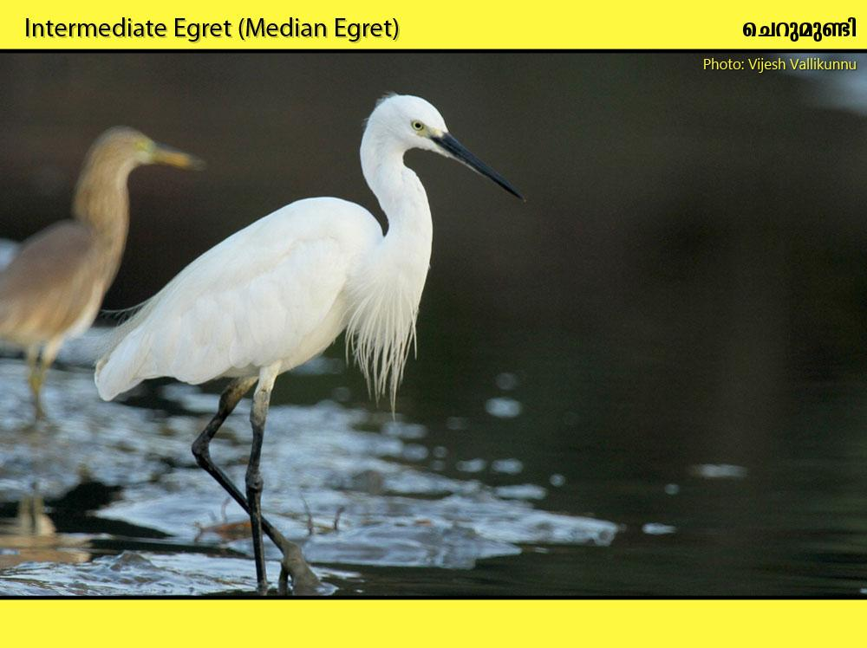
Habitat: Marshes, flooded grassland, well-vegetated pools; also shores of lakes and reservoirs, mangrove swamps and tidal creeks.

Slide 9
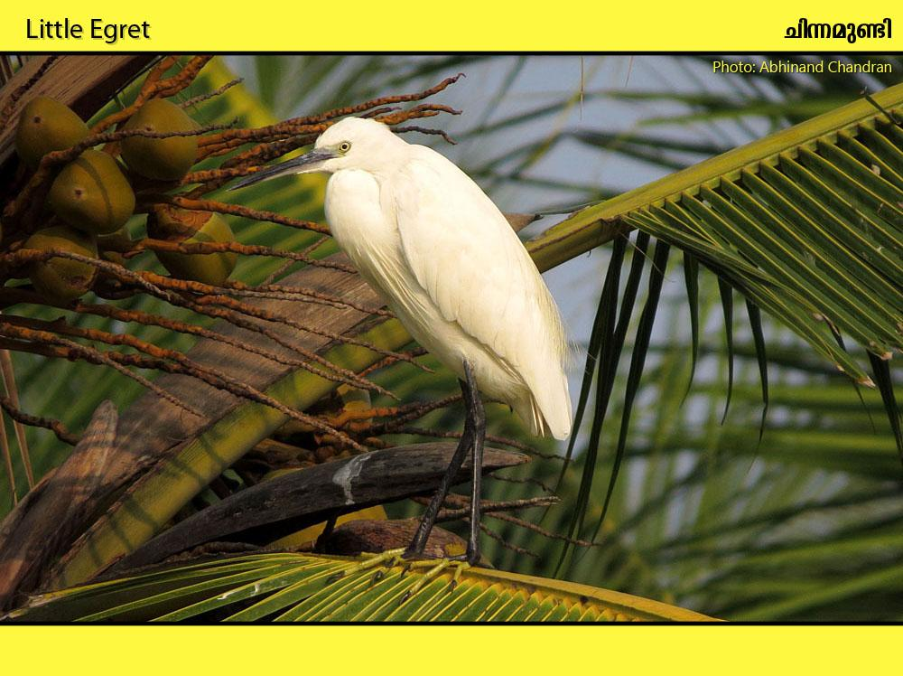
Habitat: Lakes, rivers marshes, flooded paddy-fields, also estuaries, tidal creeks and mangroves.

Slide 10
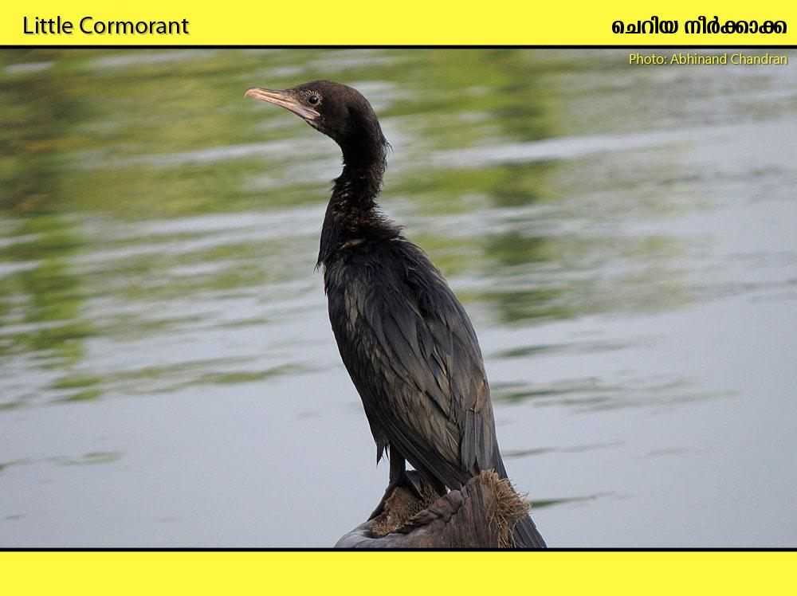
Habitat: Rivers, lakes, reservoirs, village tanks, marshes, canals, estuaries, saltpans and coastal waters.

Slide 11
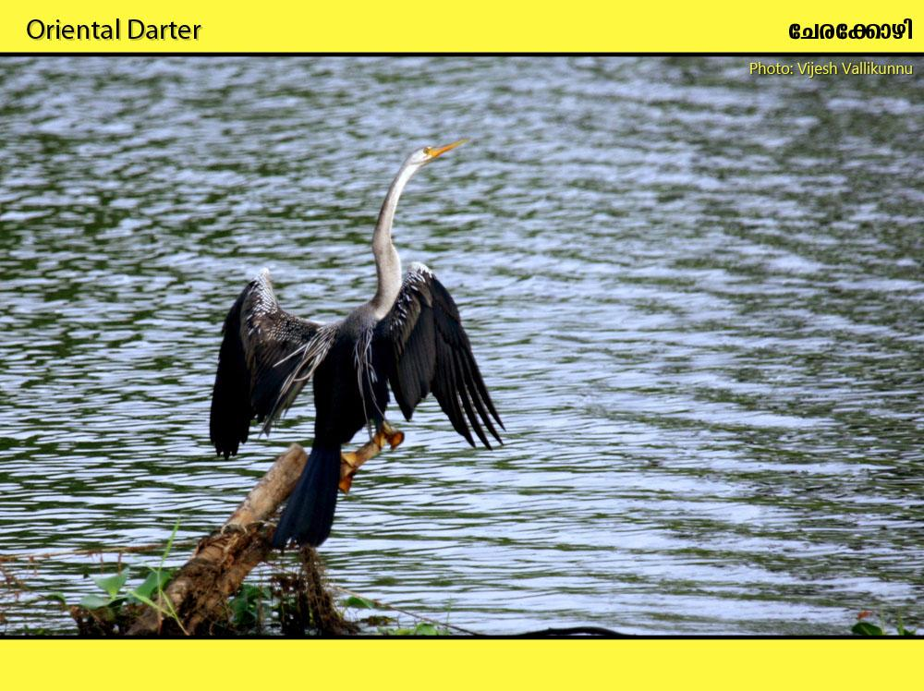
Habitat: Lakes, ponds, reservoirs, rivers, marshes and other inland waters; also mangroves and coastal waters

Slide 12
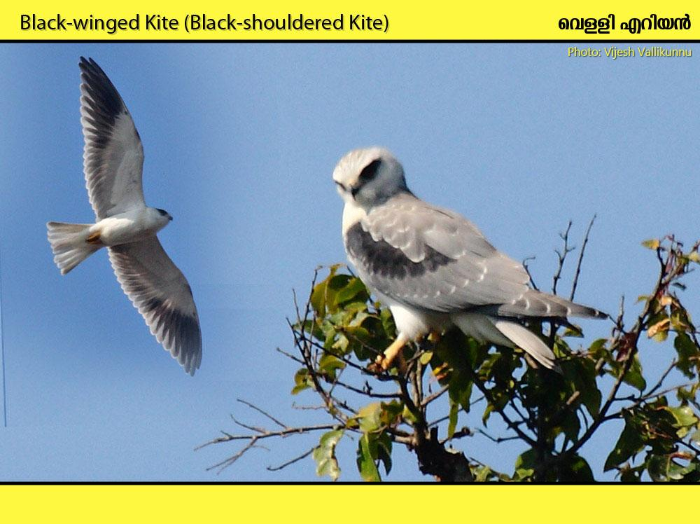
Habitat: Grassland interspersed with cultivation or with scattered trees, and scrub desert.

Slide 13
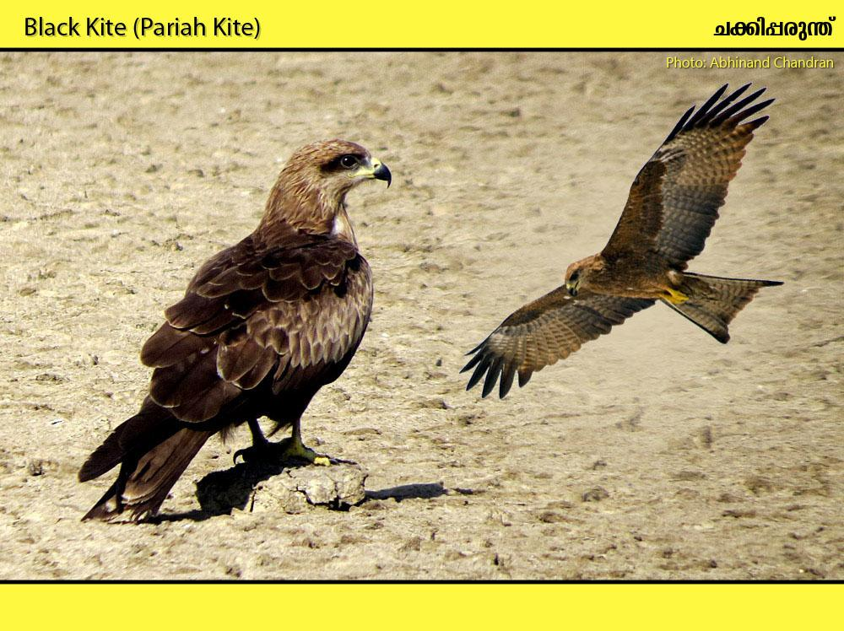
Habitat: Mainly occurs around cities, towns and villages, also mountains.

Slide 14
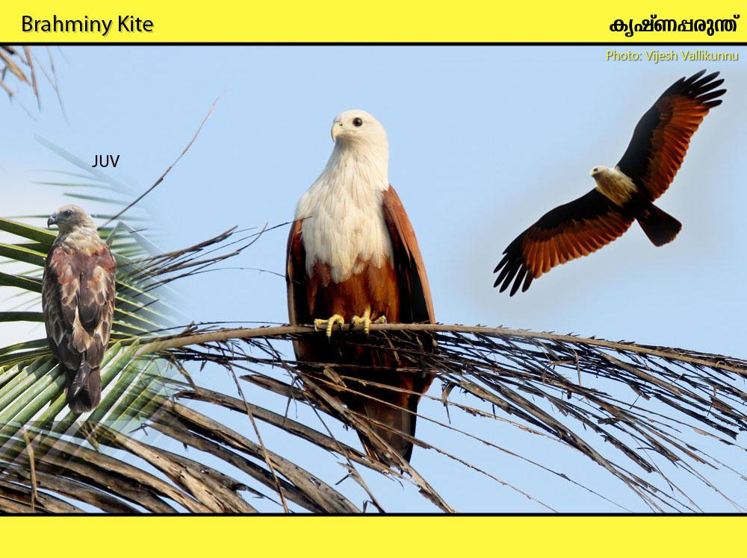
Habitat: Marshes, flooded paddy-fields, tanks, reservoirs, rivers, lakes, estuaries, harbours, coastal lagoons, mangroves and fishing villages.

Slide 15
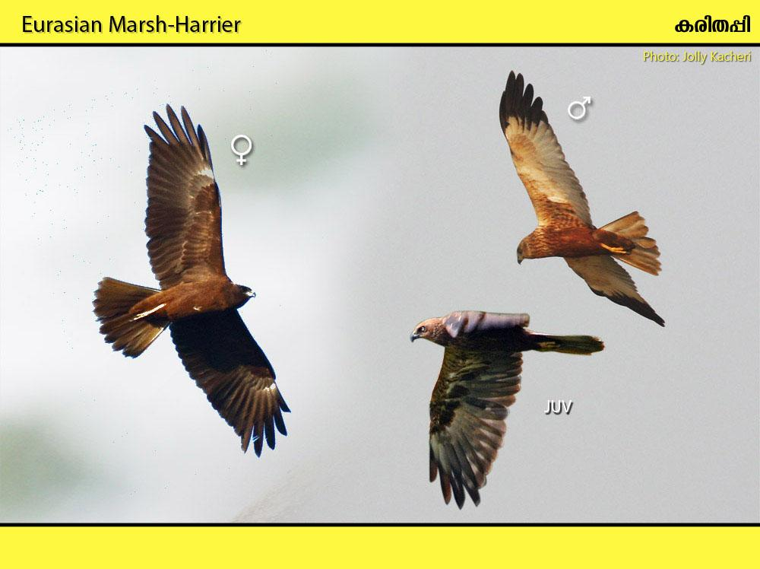
Habitat: Marshes, lakes, flooded fields

Slide 16
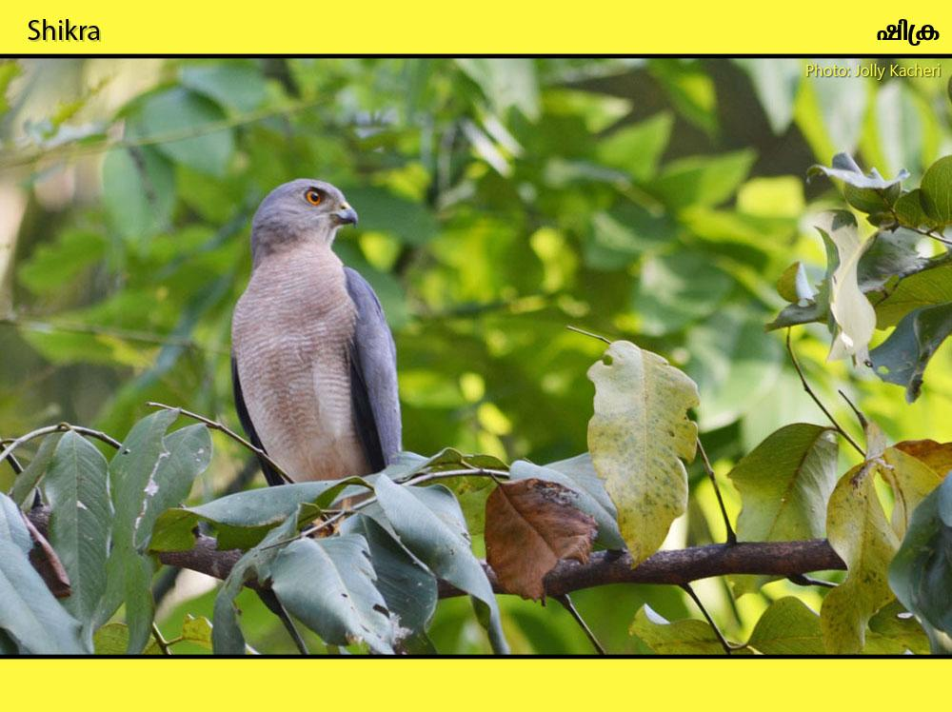
Habitat: Open wooded country.

Slide 17
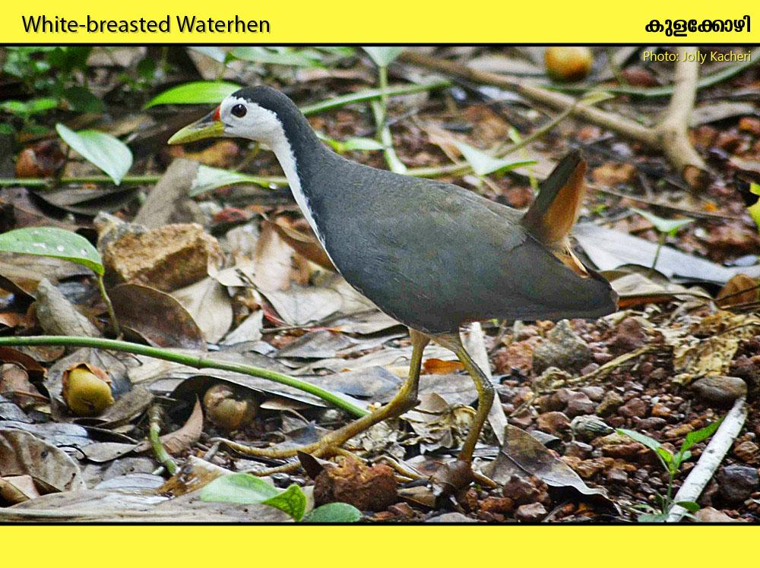
Habitat: Thick cover close to fresh waters.

Slide 18
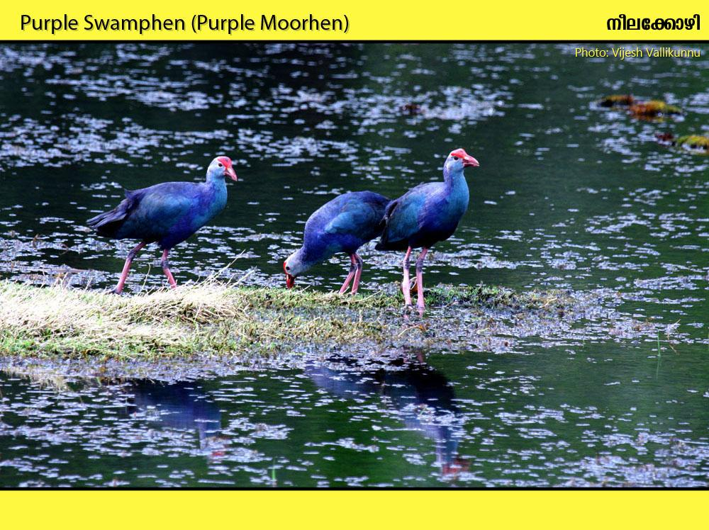
Habitat: Large marshes and extensive reed beds bordering wetlands.

Slide 19
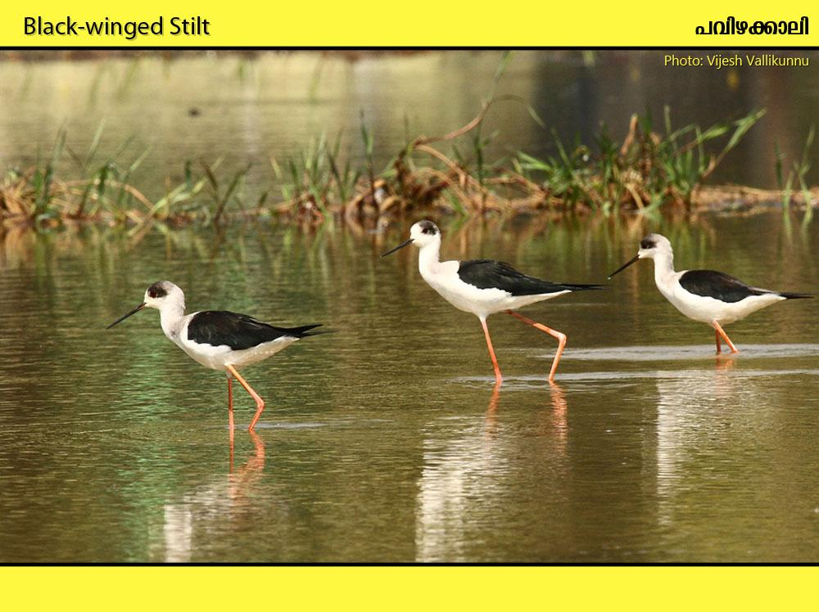
Habitat: Freshwater wetlands, brackish marshes, irrigation tanks and saltpans.

Slide 20
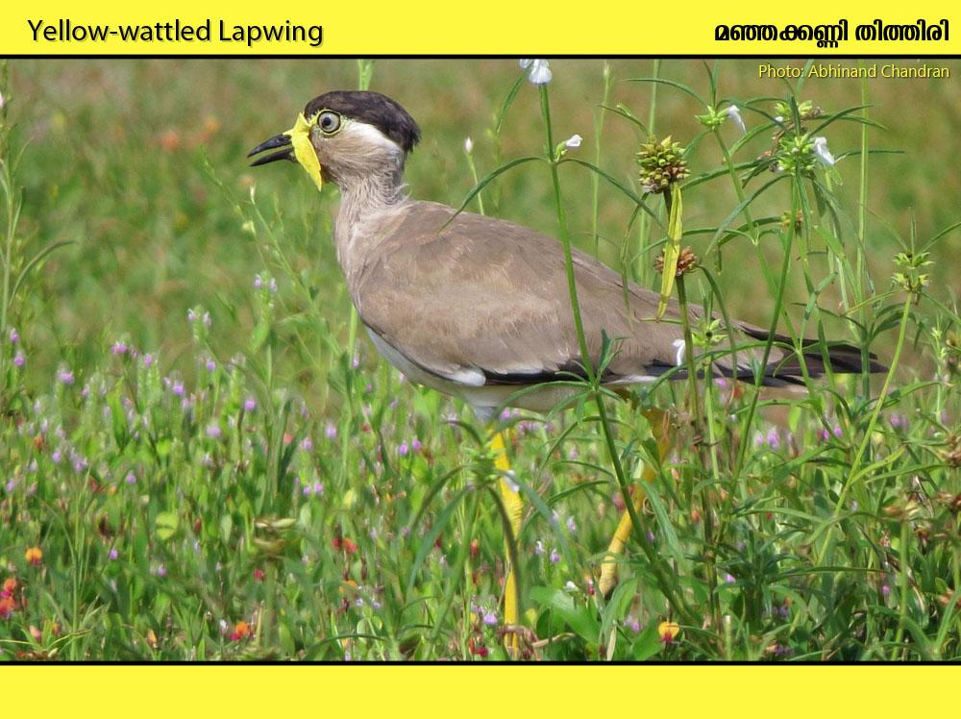
Habitat: Dry stubbles, fallow fields, stony ground and open dry country.

Slide 21
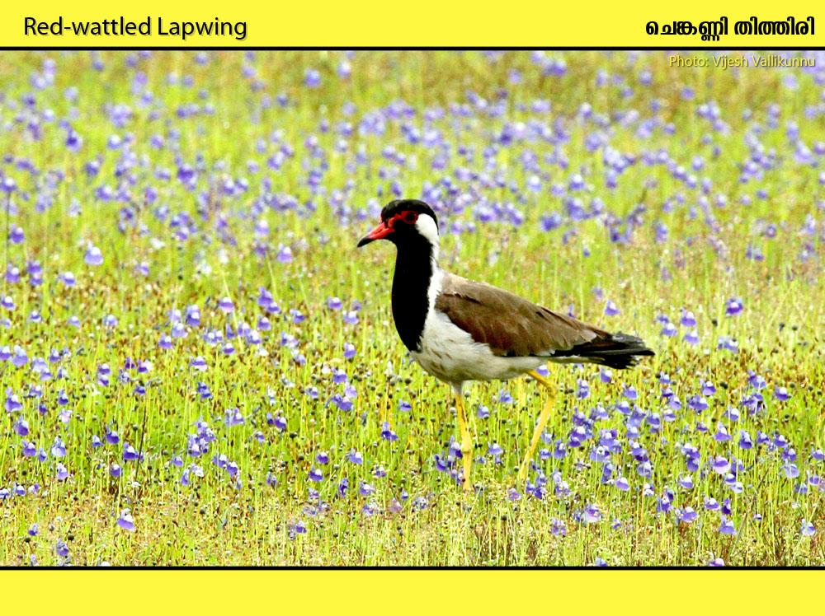
Habitat: Paddy-fields, wetlands, Open flat ground near water

Slide 22
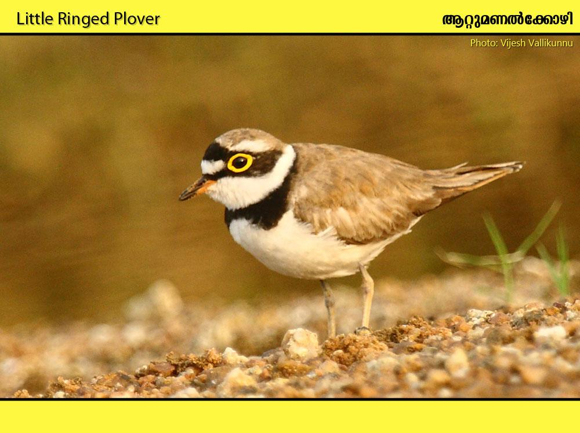
Habitat: Freshwater and coastal wetlands.

Slide 23
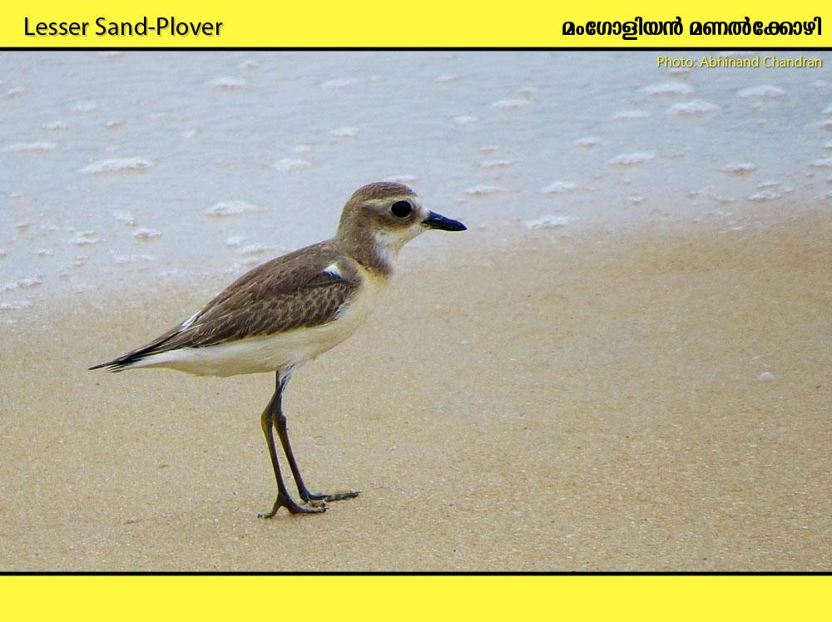
Habitat: River banks, estuaries, coastal wetlands.

Slide 24
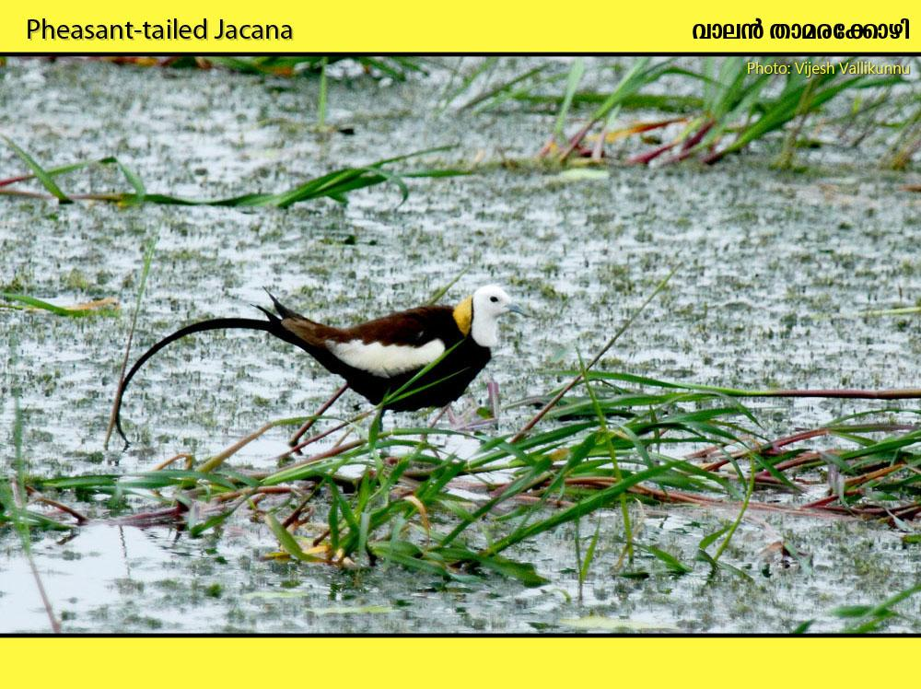
Habitat: Freshwater wetlands well vegetated with floating plants.

Slide 25
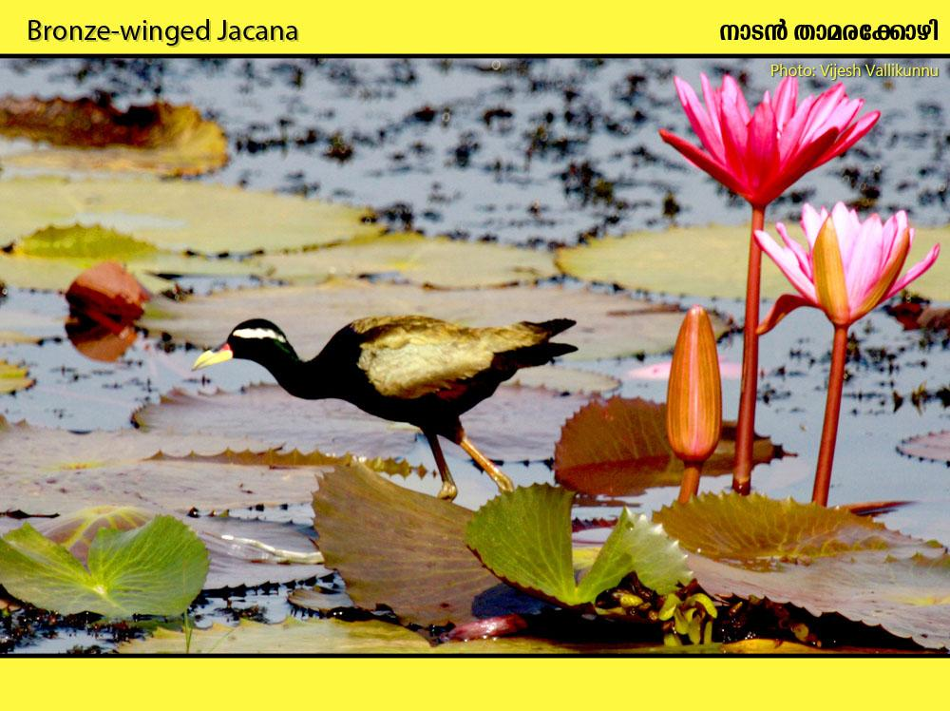
Habitat: Freshwater wetlands well vegetated with floating plants.

Slide 26
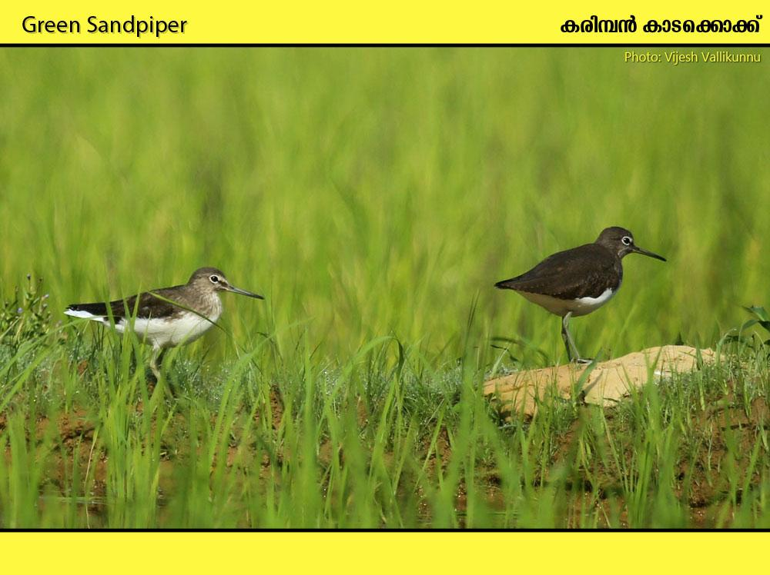
Habitat: Mainly freshwater wetlands.

Slide 27
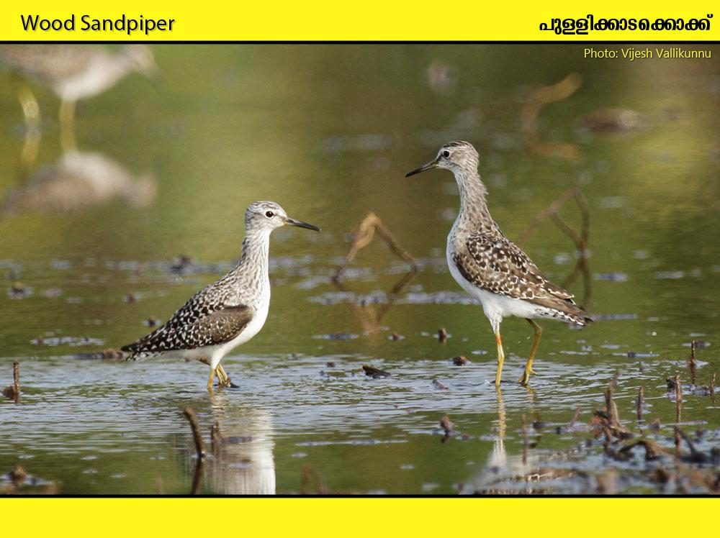
Habitat: Tidal mudflats, mangroves, wetlands, reservoir edges

Slide 28
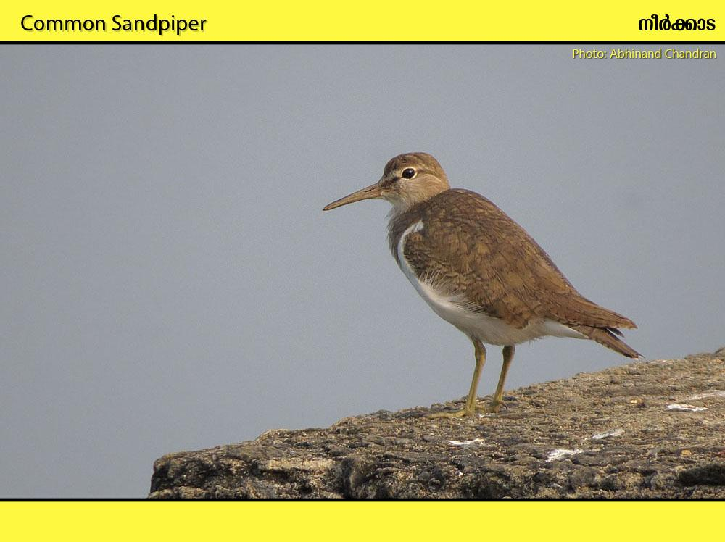
Habitat: Streams, riverbanks, paddyfields, seashore, tidal mudflats and estuaries

Slide 29
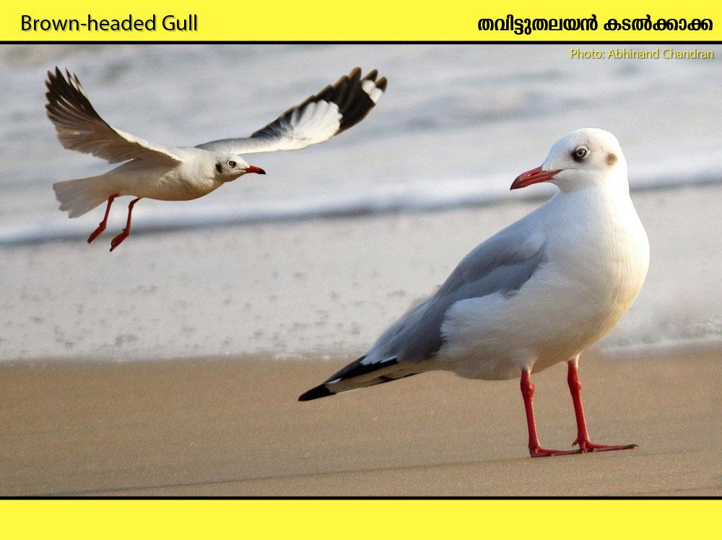
Habitat: Coasts, tidal creeks and large inland lakes and rivers.

Slide 30
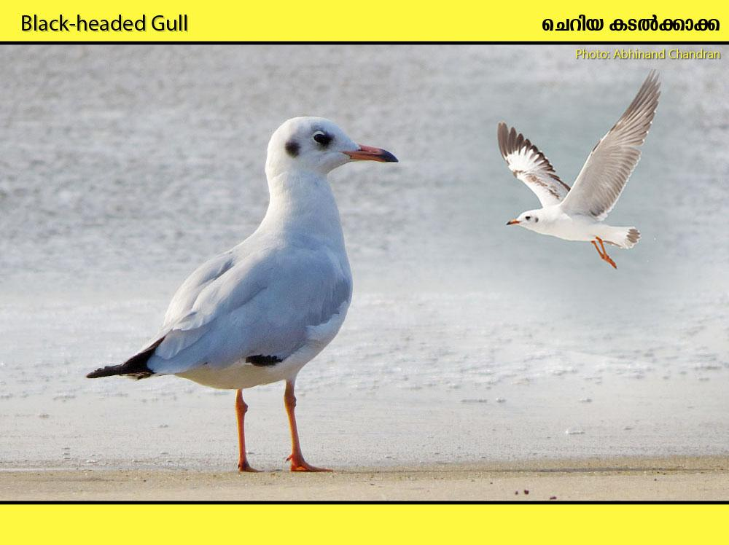
Habitat: Coasts, harbours, fishing villages, estuaries, large rivers and inland lakes.

Slide 31
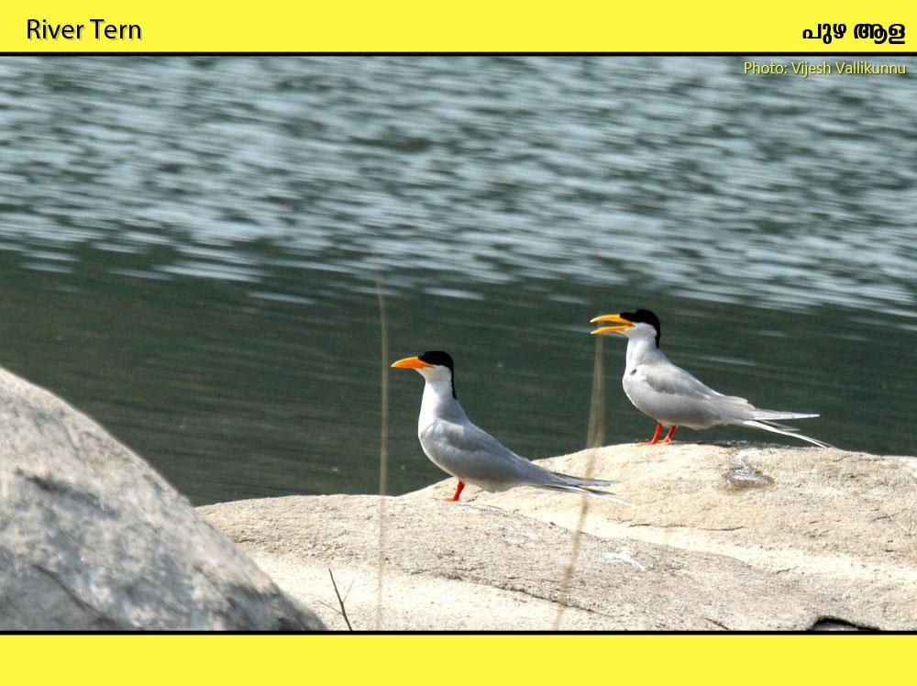
Habitat: Reservoirs, large rivers and tanks

Slide 32
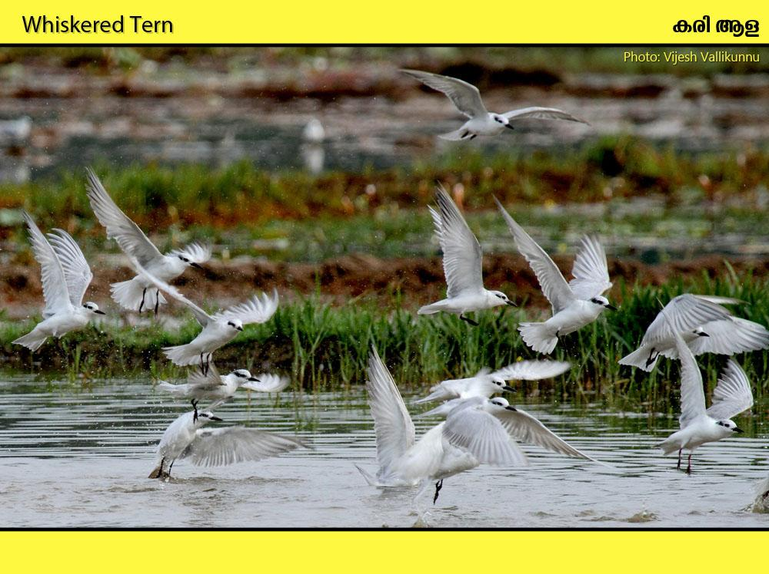
Habitat: Flooded paddyfields, rivers, wetlands, backwaters, lagoons etc

Slide 33
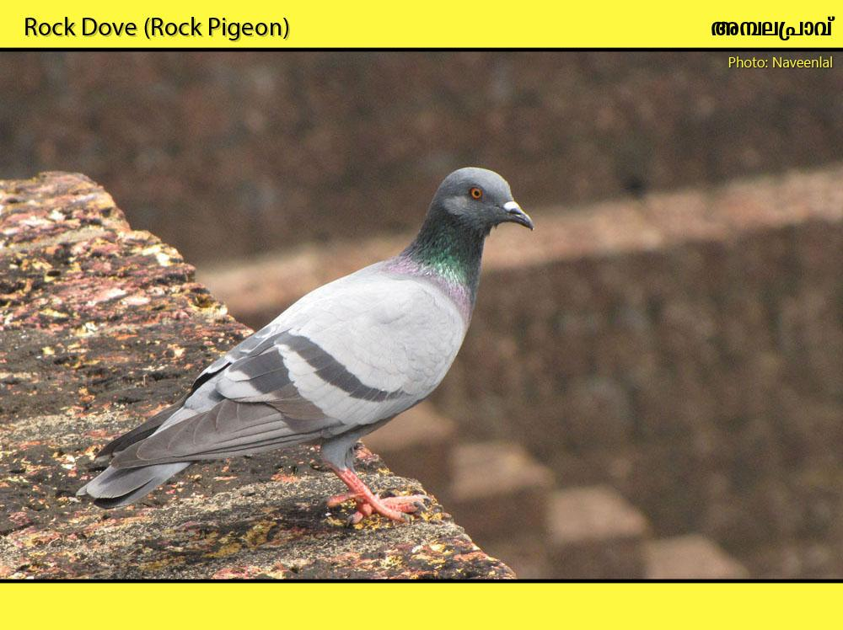
Habitat: Around human habitations and cultivation

Slide 34
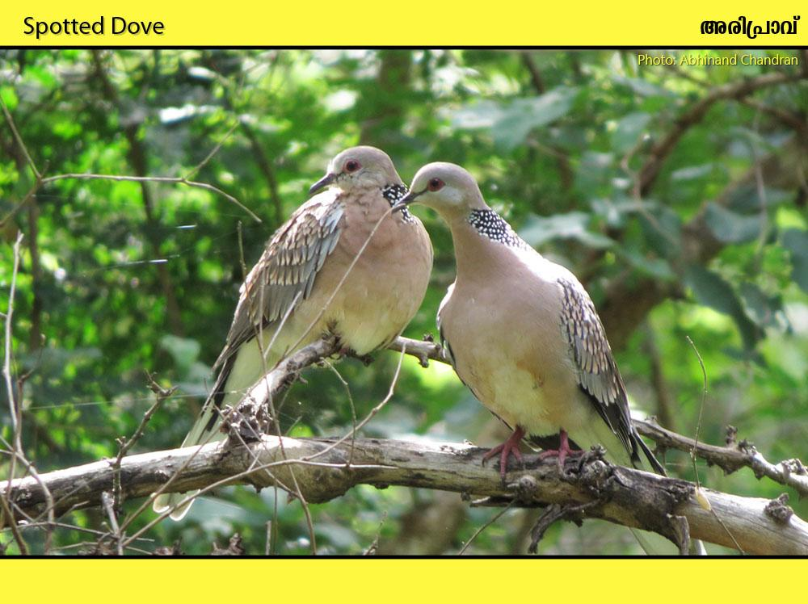
Habitat: Cultivation, open forests.

Slide 35
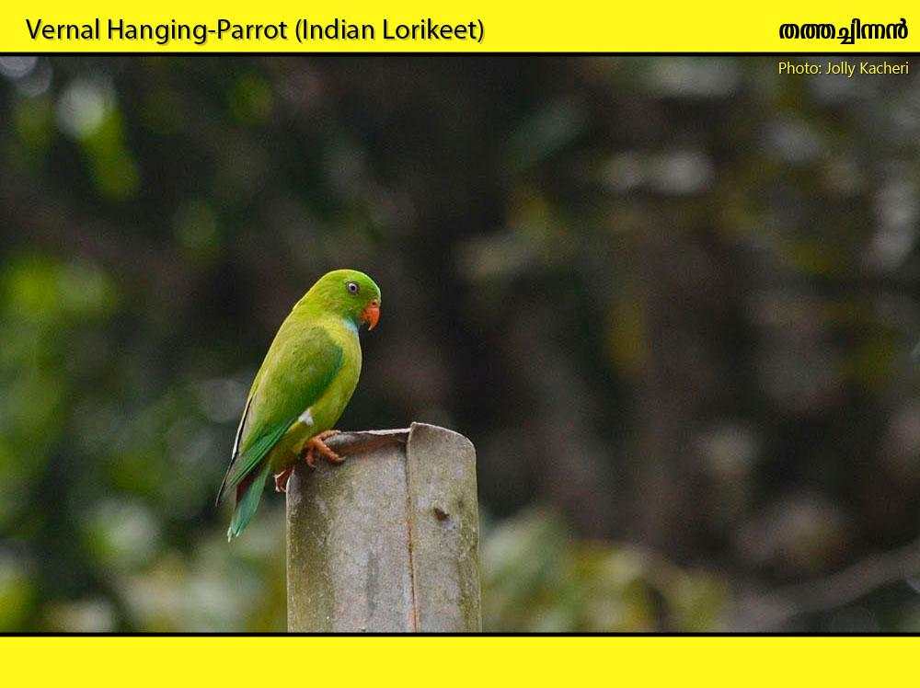
Habitat: Well wooded areas, Evergreen and moist deciduous forest.

Slide 36
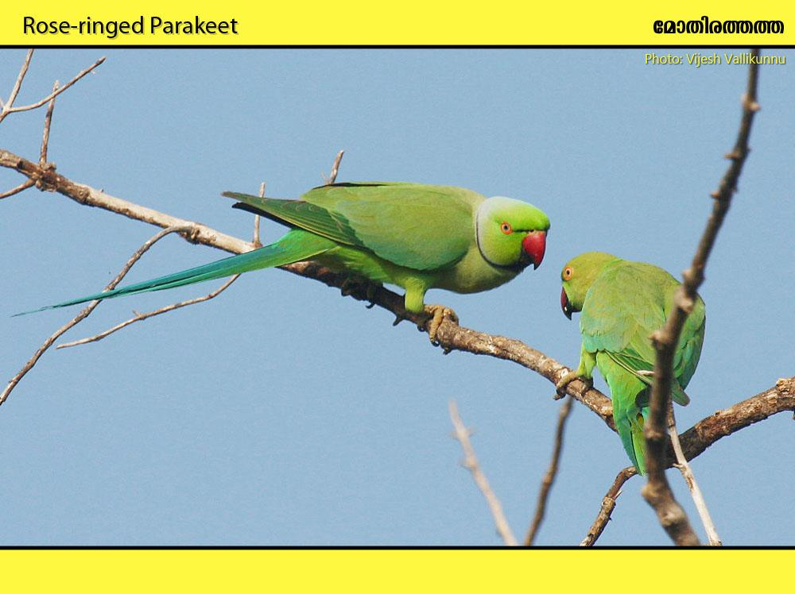
Habitat: Human habitations, wooded areas, cultivation

Slide 37
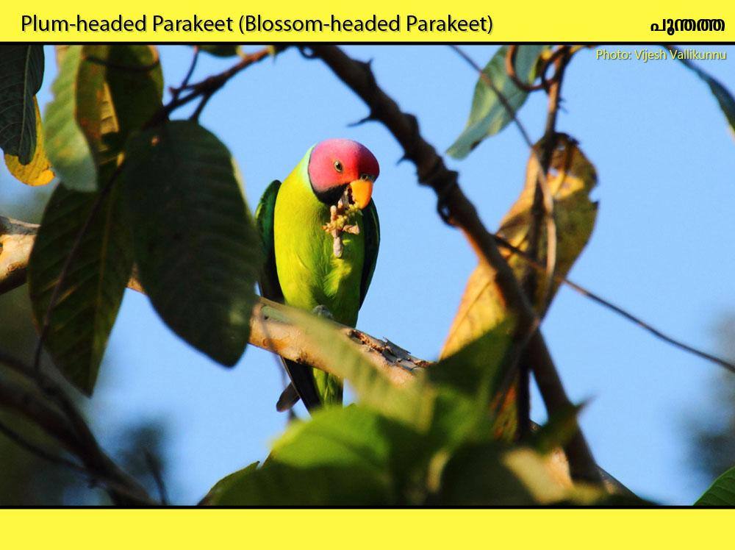
Habitat: Forest, plantations and well-wooded areas.

Slide 38
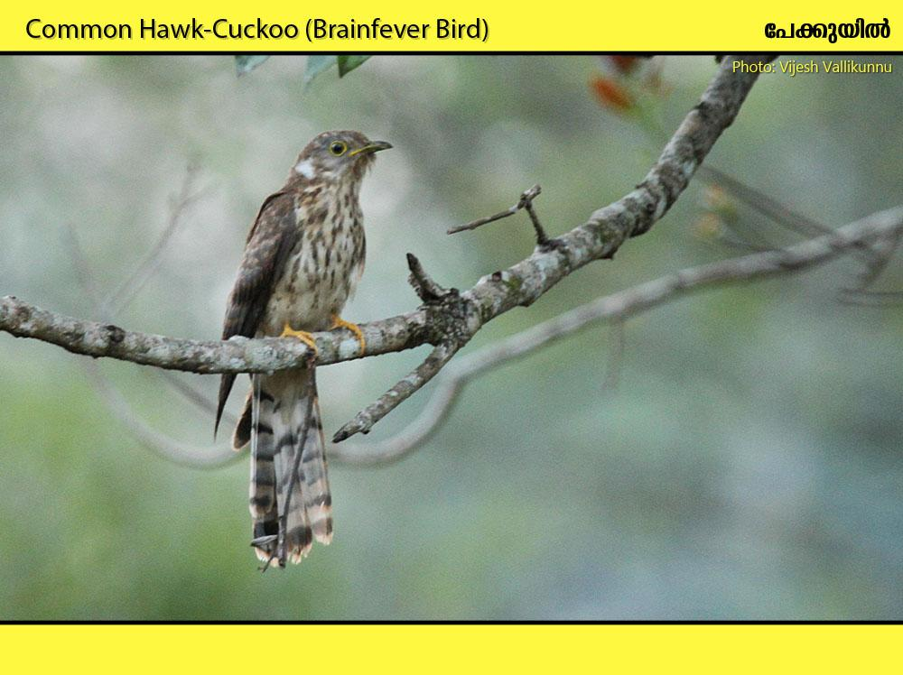
Habitat: Well-wooded country, plantations, forests

Slide 39
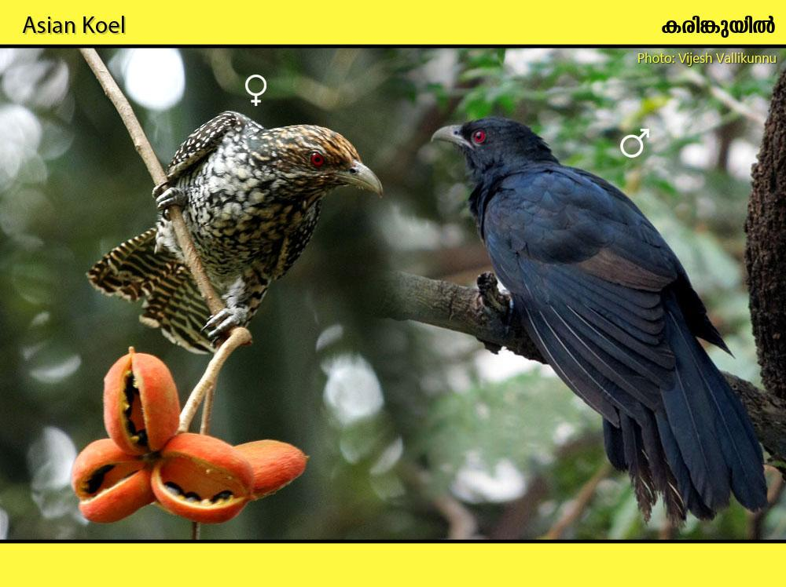
Habitat: Gardens, cultivations near human habitation. Found in villages, cities, towns etc

Slide 40
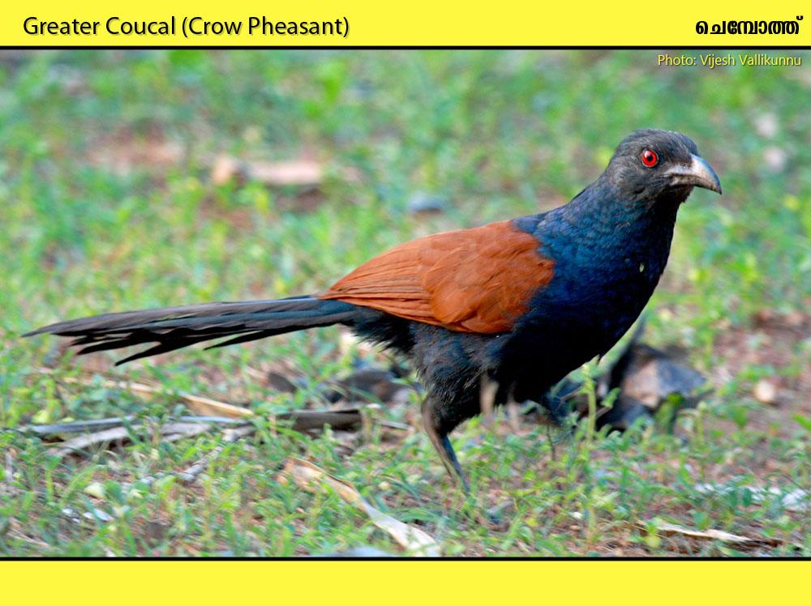
Habitat: Human habitations, cultivation, open country

Slide 41
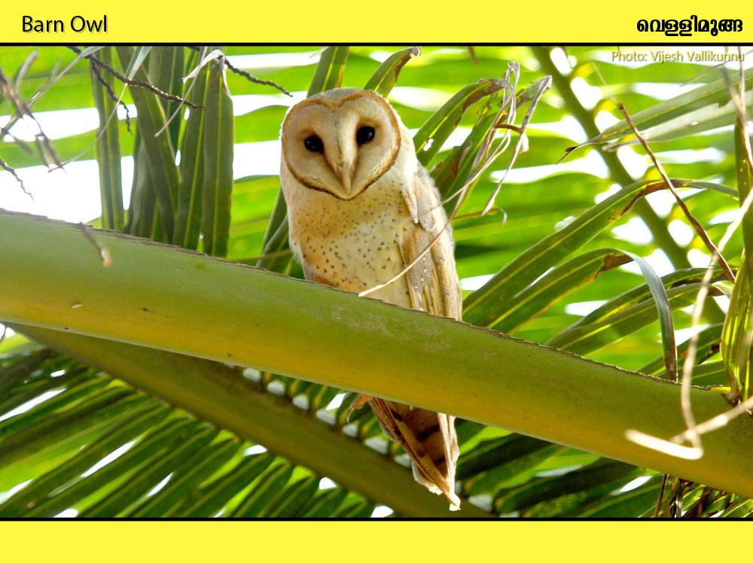
Habitat: Around human habitations and cultivation. Villages, towns, cities etc

Slide 42
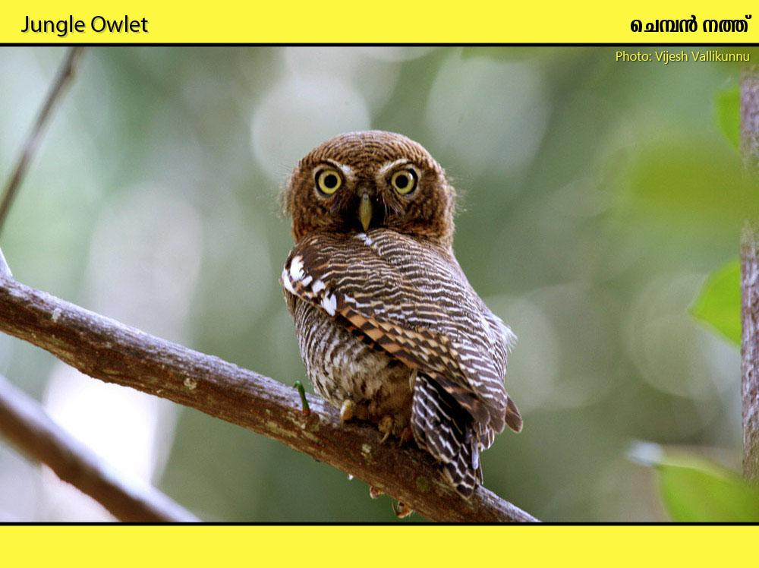
Habitat: Well wooded areas around villages and towns. Forests, plantations

Slide 43
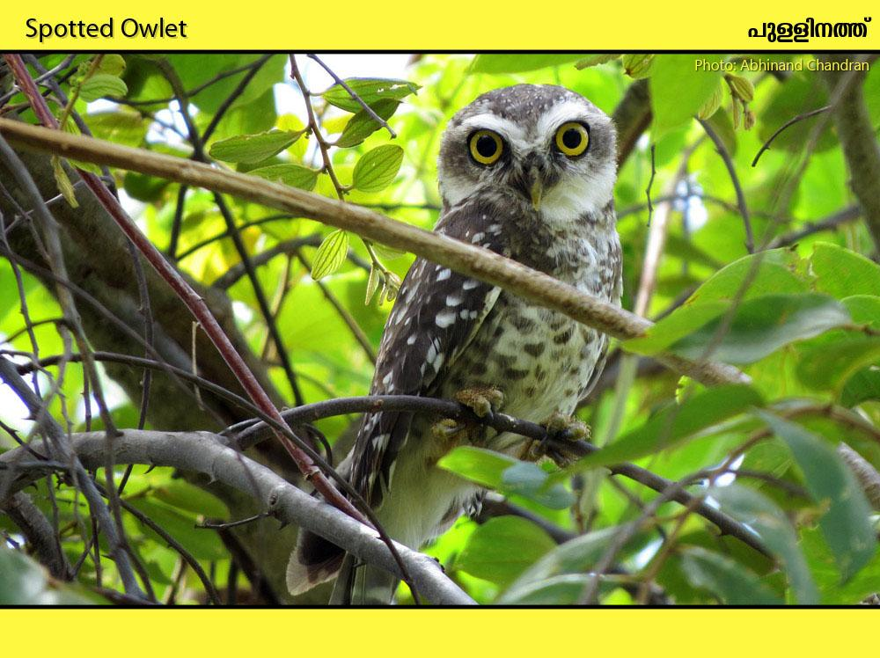
Habitat: Well wooded areas around villages and towns. Buildings, plantations

Slide 44
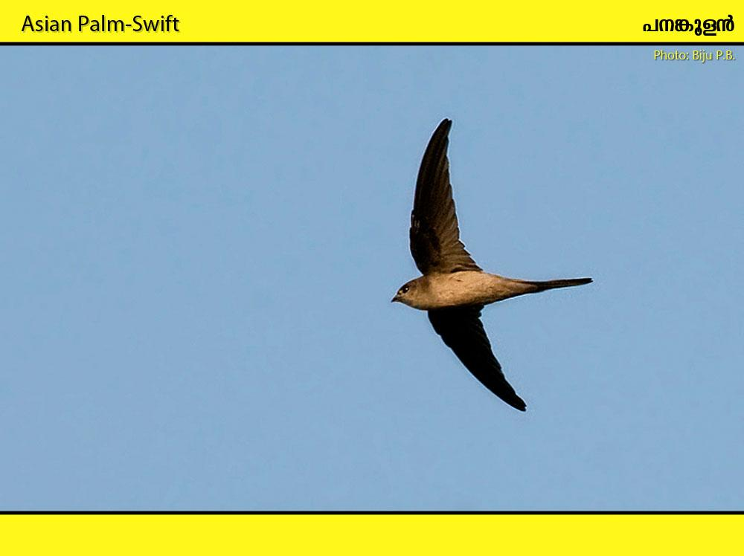
Habitat: Hawks insects around palms. Open country and cultivation; closely associated with palms.

Slide 45
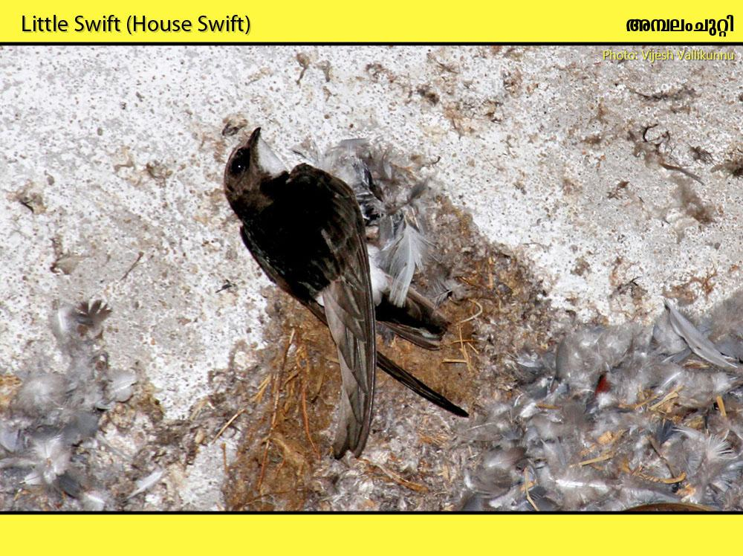
Habitat: Human habitations, bridges, dams, cliffs

Slide 46
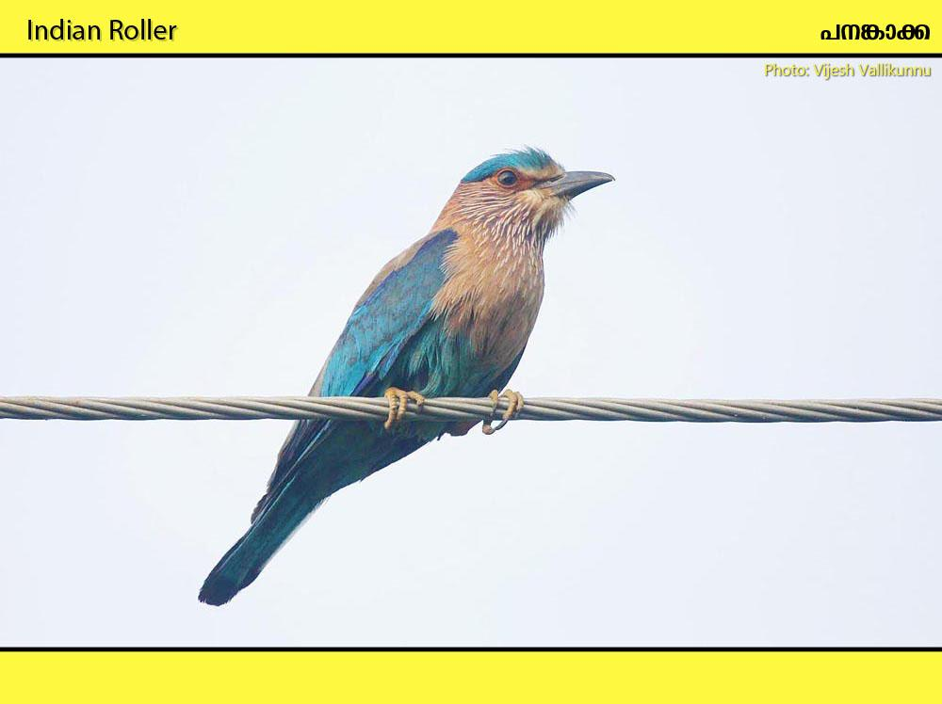
Habitat: Cultivation, open country, dry paddyfields

Slide 47
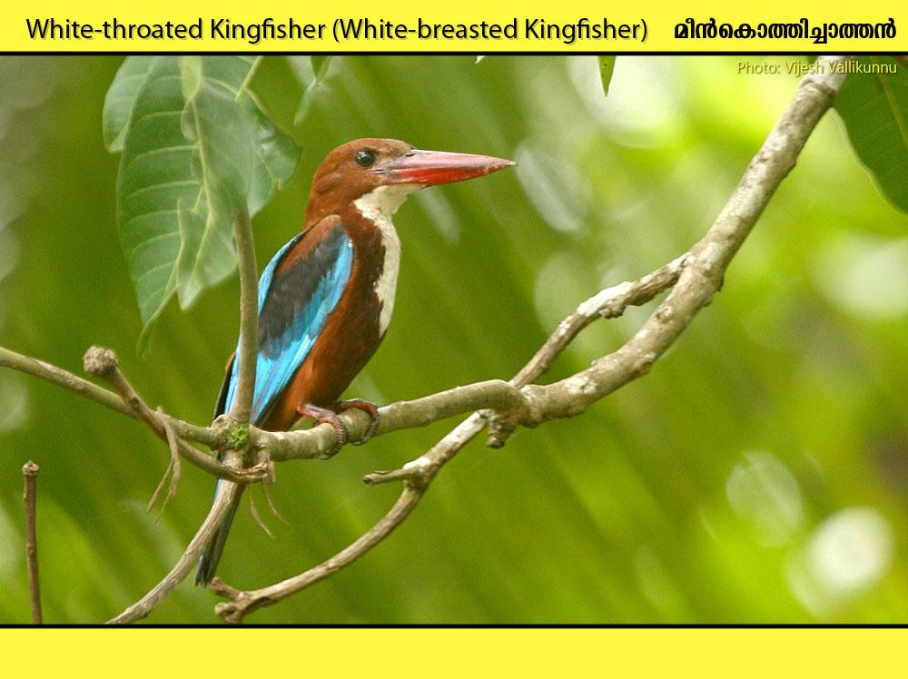
Habitat: Wide-ranging habitat, often far from water: cultivation, forest edges, gardens, and freshwater and coastal wetlands

Slide 48
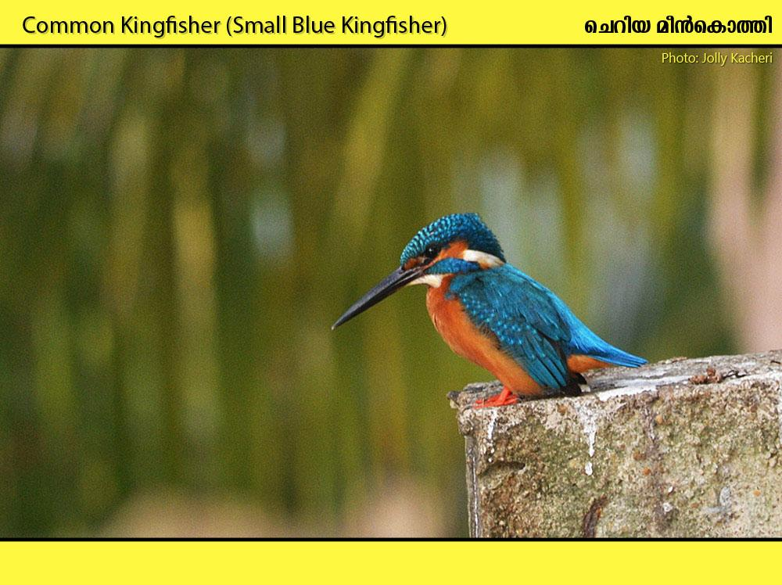
Habitat: Found near waterbodies like ponds, lakes, streams, coastal backwaters

Slide 49
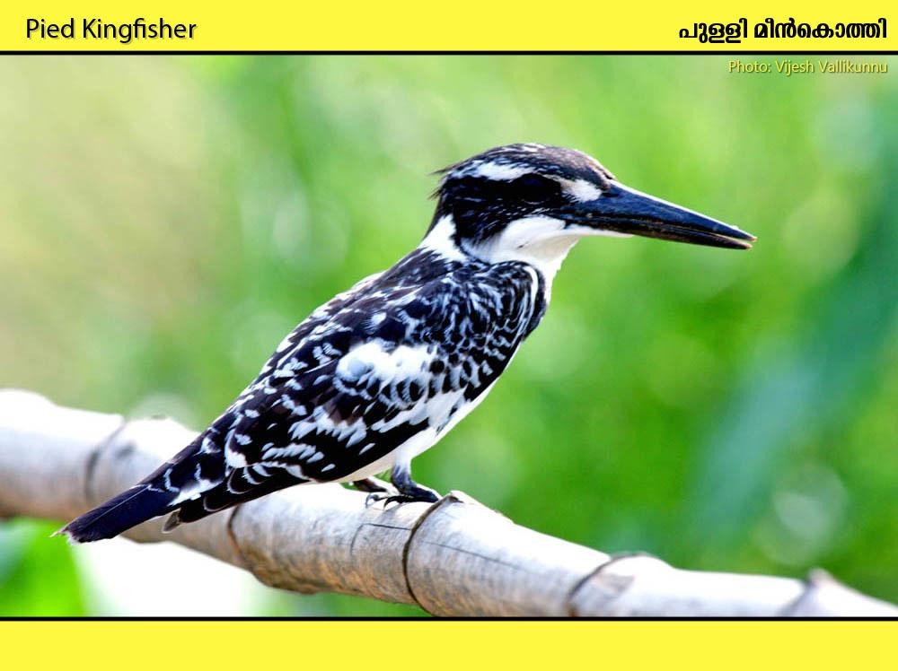
Habitat: Still fresh waters, slow-moving rivers and streams, also tidal creeks and pools.

Slide 50
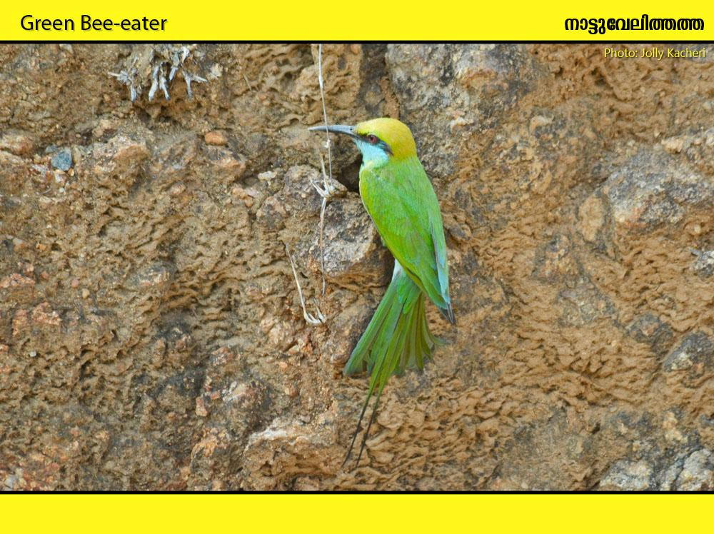
Habitat: Open country with scattered trees; sandy areas on coasts; also semi-desert and grazing land.

Slide 51
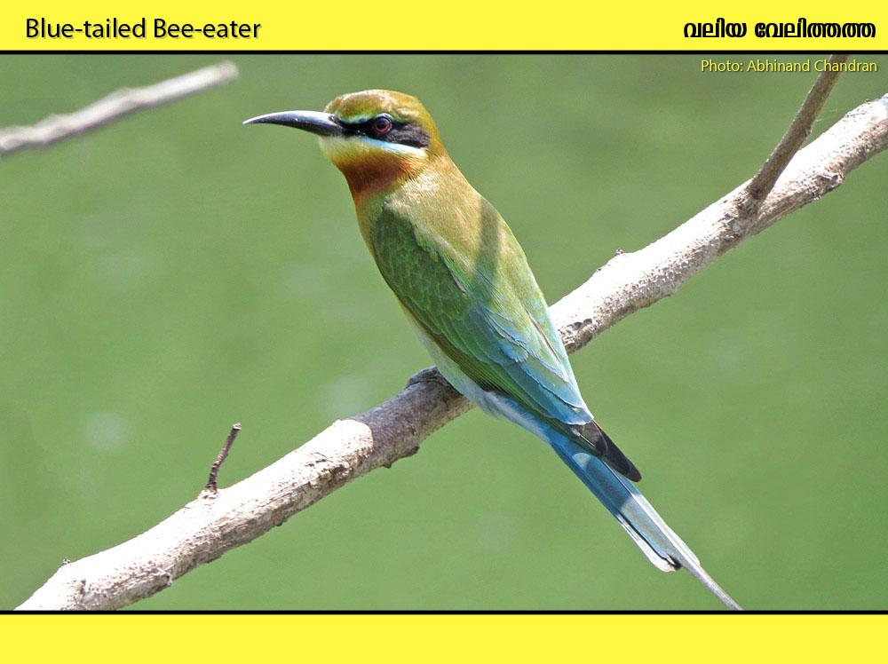
Habitat: Near waterbodies, wetlands

Slide 52

Habitat: Forests, well wooded areas, gardens, groves.

Slide 53

Habitat: Open wooded country, groves and wooded urban gardens

Slide 54

Habitat: Villages, towns, Light forest, plantations, groves and trees in open country.

Slide 55

Habitat: Well wooded areas around villages. Forests, groves

Slide 56

Habitat: Open wooded country.

Slide 57

Habitat: Well-wooded areas in villages, forests, secondary jungle

Slide 58

Habitat: Secondary growth and well-wooded areas, forests, plantations

Slide 59

Habitat: Open woodland, thin forests, well wooded areas around villages

Slide 60

Habitat: Well wooded areas, groves, plantations

Slide 61

Habitat: Well wooded areas around villages, plantations, forests

Slide 62

Habitat: Open country, scrub jungle, forest edges

Slide 63

Habitat: Well wooded areas around villages and towns. Forests, plantations

Slide 64

Habitat: Gardens, well-wooded areas, plantations, forests

Slide 65

Habitat: Paddyfields, open country, cultivation.

Slide 66

Habitat: Well-wooded areas around villages and towns, groves, forests

Slide 67

Habitat: Well wooded areas in villages, plantations, forests

Slide 68

Habitat: Forest, well-wooded areas, plantations, gardens

Slide 69

Habitat: Around human habitations, coconut groves, forests

Slide 70

Habitat: Around human habitation and cultivation.

Slide 71

Habitat: Around human habitation, well wooded areas, forest edges

Slide 72

Habitat: Well-wooded areas, scrub jungle, deciduous forest

Slide 73

Habitat: Wetlands, paddyfields, open country

Slide 74

Habitat: Open scrub, cultivation, forest clearings, coastal areas

Slide 75

Habitat: Wet paddyfields and grasslands.

Slide 76

Habitat: Bushes at forest edges, scrub and secondary growth, plantations

Slide 77

Habitat: Tall grass and scrub, open secondary growth near water and reedbeds.

Slide 78

Habitat: Tall crops, reeds, grassland, scrub and tall grass, and mangroves.

Slide 79

Habitat: Open forest, scrub jungle, gardens, orchards and bushes around villages and cultivation

Slide 80

Habitat: Open deciduous forest, secondary growth, gardens and light scrub.

Slide 81

Habitat: Bushes in gardens, cultivation edges and forest edges.

Slide 82

Habitat: Reeds in wetlands, mangroves, Bushes and trees at edges of forest, cultivation and in wooded areas.

Slide 83

Habitat: Well-wooded areas in villages and towns, forests, secondary jungle

Slide 84

Habitat: Human habitations, well wooded areas, plantations, secondary jungle

Slide 85

Habitat: Human habitations, open areas, secondary forests

Slide 86

Habitat: Habitations and cultivation.

Slide 87

Habitat: Cultivation near well-wooded areas, grasslands, paddyfields

Slide 88

Habitat: Well wooded villages, groves, plantations, forests

Slide 89

Habitat: Around human habitations, light forests

Slide 90

Habitat: Dry stony areas with scrub and cultivation edges, dry paddyfields

Slide 91

Habitat: Homesteads, towns and villages, groves, forests

Slide 92

Habitat: Homesteads, towns and villages, gardens, groves, plantations

Slide 93

Habitat: Hardens, villages, thin forests. Prefers more drier habitations

Slide 94

Habitat: Well-wooded villages and gardens, plantations, forests

Slide 95

Habitat: Widespread resident in villages and towns

Slide 96

Habitat: Wetlands, paddyfields, waterbodies with crops

Slide 97

Habitat: Homesteads, gardens, paddyfields, cultivations

Slide 98

Habitat: Homesteads, gardens, cultivations, open forests

Slide 99

Habitat: Banks of rivers, pools, lakes, canals and irrigation barrages.

Slide 100

Habitat: Slower streams in lowlands and foothills, wetlands

Slide 101

Habitat: Wet and fallow paddyfields, short grasslands

Slide 102
THANK YOU
Special thanks to all photographers who shared their valuable images

