Slide 1

Using eBird
A beginner’s guide to listing
Common Bird Monitoring Program
2016
eBird India

Slide 2



What is eBird?
A global, internet-based checklist program
for gathering observations of birds
for birders to maintain their personal records.
In this way, eBird
gathers baseline data on bird distribution and abundance
disseminates information for public and scientific use
Backend for global programmes like Great Backyard Bird Count (GBBC) – we use GBBC for Common Bird Monitoring.

Slide 3
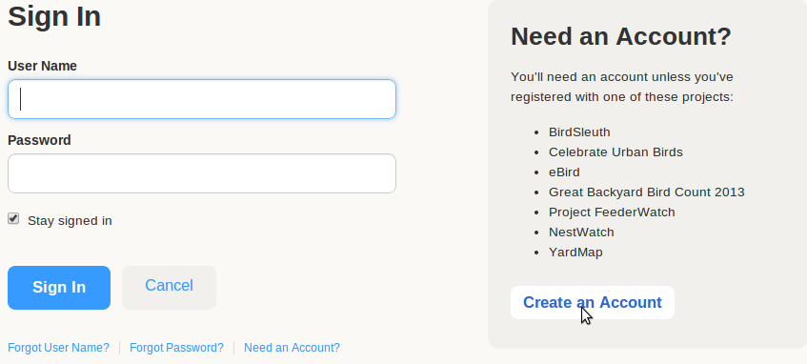
Creating an account
Go to www.ebird.org to sign up for a free account

Slide 4
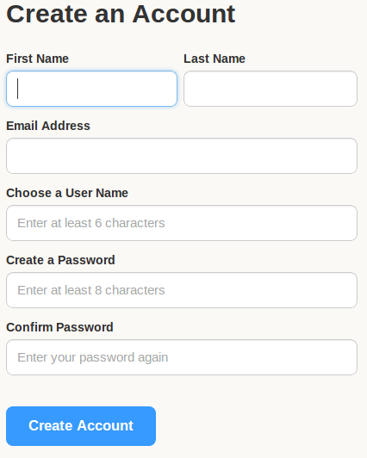
Creating an account

Slide 5
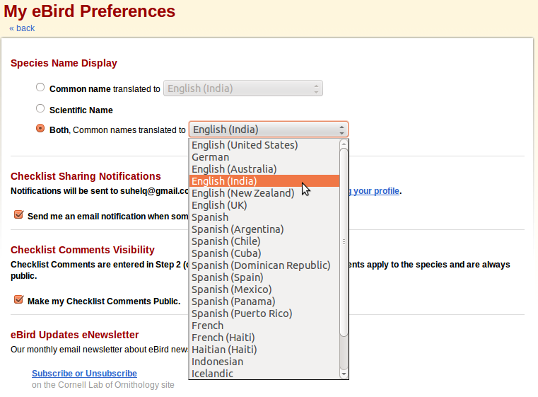
Setting account preferences
Set your preferences so that you see names you are used to!
Choose “Species Name Display” as: English (India)

Slide 6

Submitting a list
Here is a step-by-step guide to submitting a bird list
Click on ‘Submit Observations’ after logging in

Slide 7
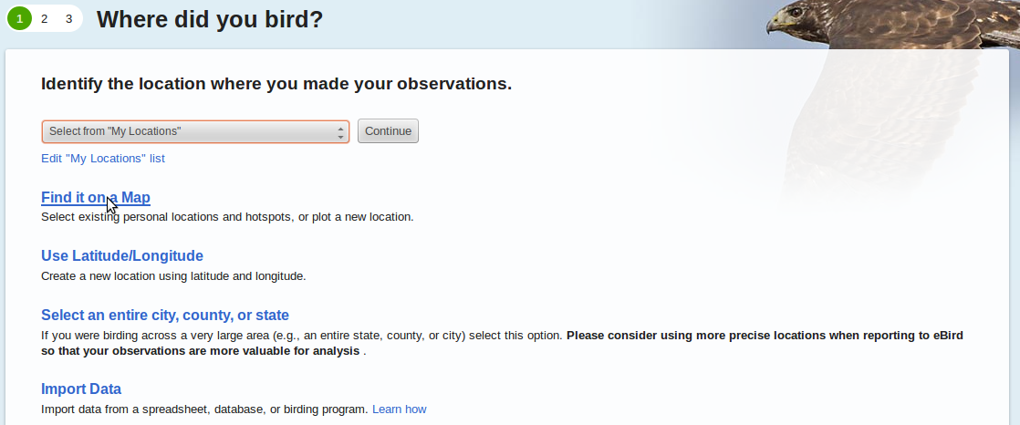
Submitting a list
The first time you submit a list, choose ‘Find it on a Map’

Slide 8
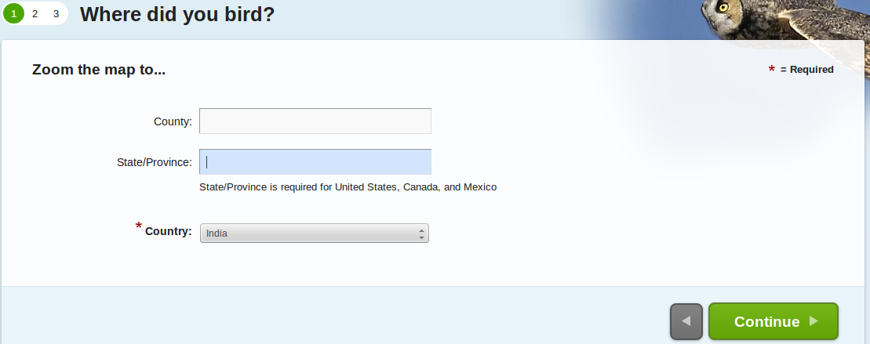
Submitting a list
Select Country as India, and leave the rest blank

Slide 9
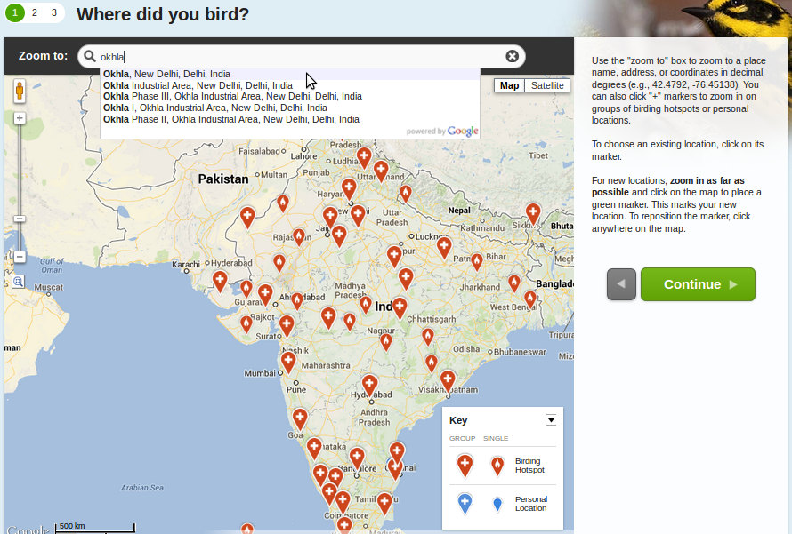
Submitting a list
Begin typing in the search box to find a location near you

Slide 10
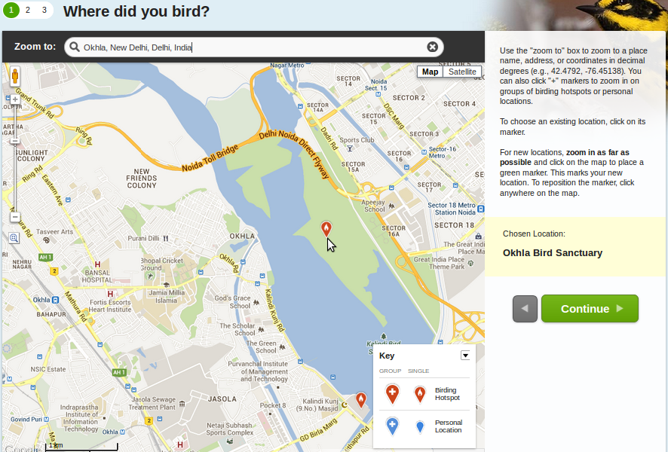
Submitting a list
An existing red marker indicates a public birding location (or ‘hotspot’)
If this is your location, click on the red marker to choose it

Slide 11
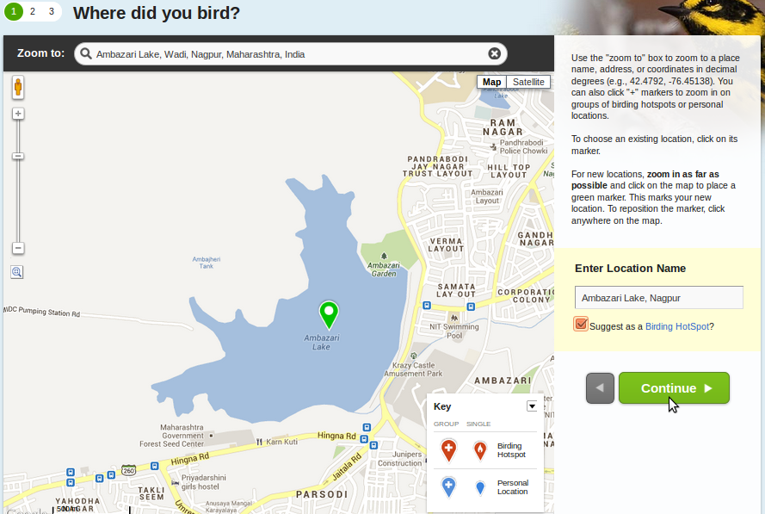
Submitting a list
If there is no existing marker, click on your location and add a name
Suggest it as a ‘hotspot’ unless it is a private location (eg, your home)

Slide 12
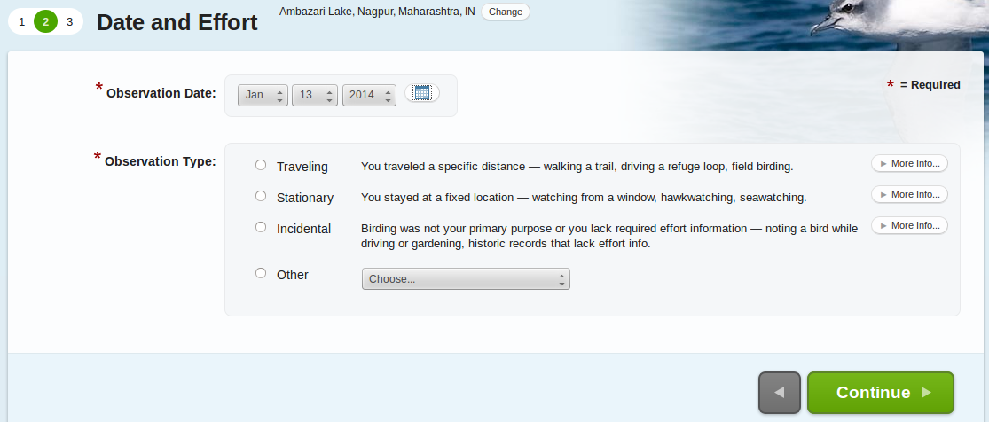
Submitting a list
On the next screen, select the date of your list, and the type of list
Most lists fall under one of the three types listed

Slide 13
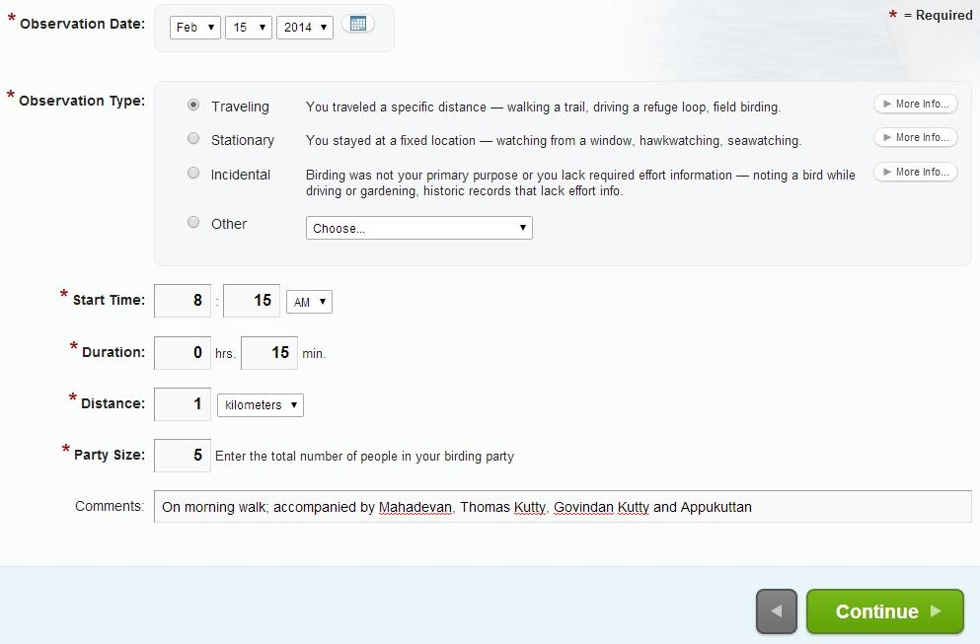
Submitting a list
Once an Observation Type is selected, add more information about your birding effort; and add comments for your later reference

Slide 14
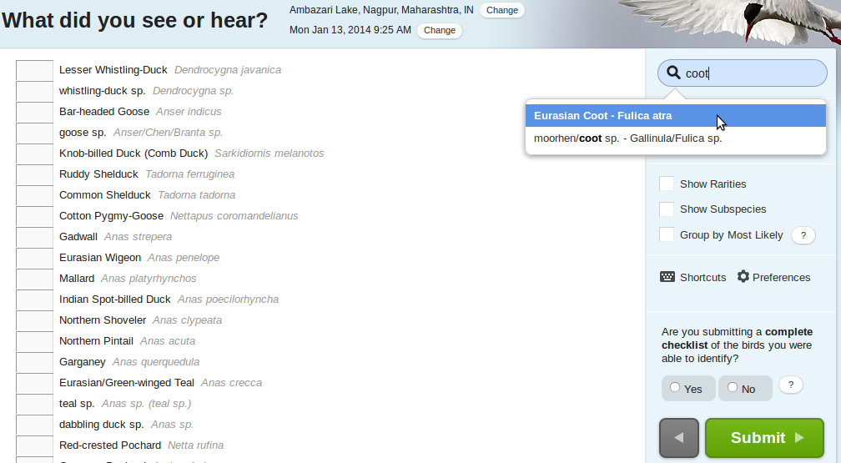
Submitting a list
Now to your bird list! Search for the first species using the box at top right.
When you select the species...

Slide 15
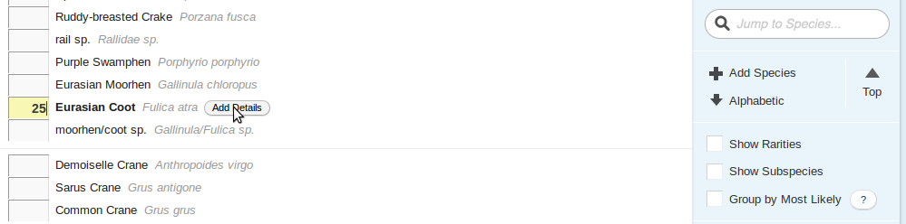
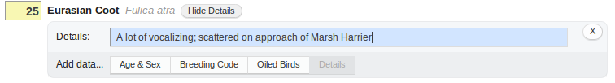
Submitting a list
… the page automatically scrolls down to the text box for that species, where you can enter your count...
… and add further details and comments if you wish
If you haven’t counted individuals, type an ‘X’ in the box, indicating that you have seen/heard the species

Slide 16
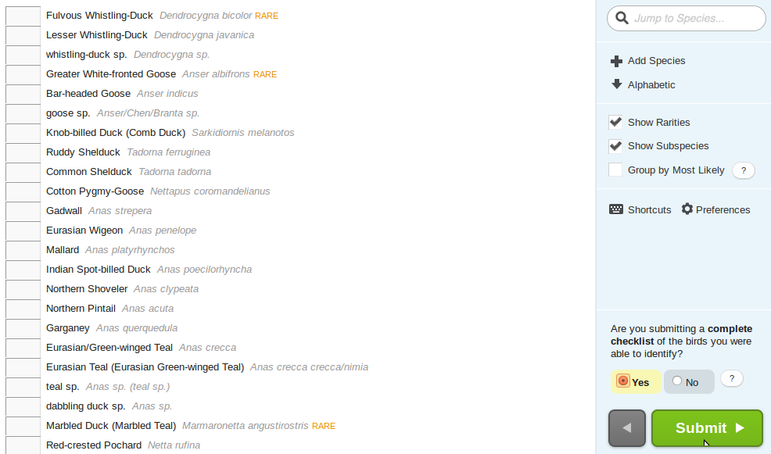
Submitting a list
When done, you will be asked whether you are submitting a complete list. Say ‘Yes’
Atleast three such 15 minutes list every day between 13-16 February 2014

Slide 17
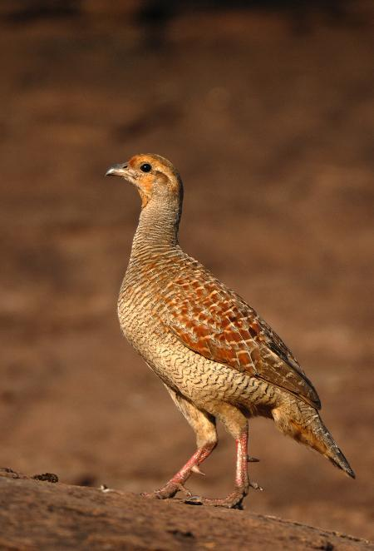
Further information
Global
eBird main website (www.ebird.org), and online help (help.ebird.org)
eBird on Facebook and Twitter
India
BirdCount India (eBird in India): Google group, Facebook, Twitter
Further questions? Email birdcountindia@gmail.com

